Slide 1

Change Control Application
Circle K Stores, Inc.
Presented by The Notifier
Point Of Contact: Kevin Reed
Title: Unix Systems Senior Analyst - IT Systems

Slide 2
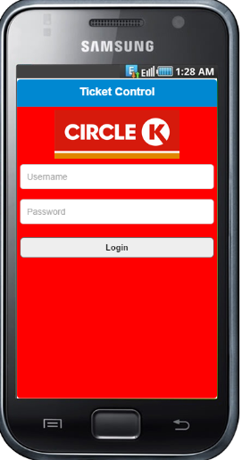
Login Page

Slide 3
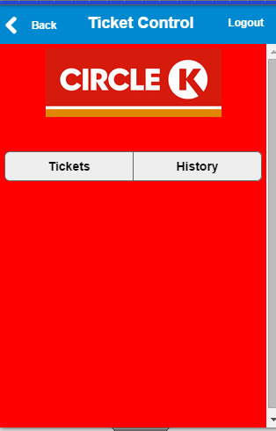
Main Page

Slide 4
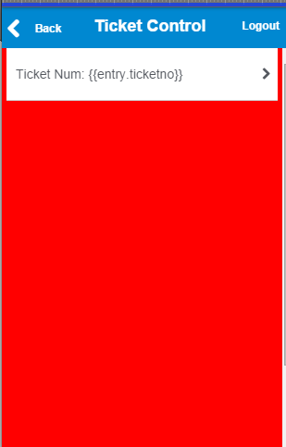
Tickets Page

Slide 5
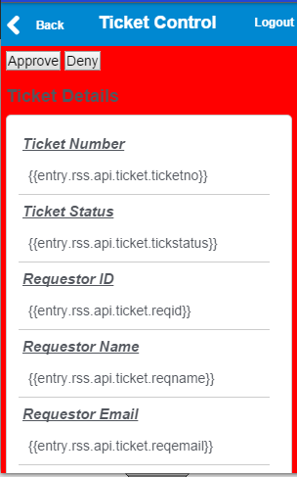
Detail Ticket

Slide 6
Feedback
User are:
Client
Client Co-worker
Our team
Need to change
Login-Validation of users
Main page- Welcome message that show the user Name and information
Move the Ticket and History tab down to the page
Detail Ticket Page
Shorten the detail page
Add a “Top page” function to allow user can go back up to the top page
Need to add an approve page.

